Slide 1
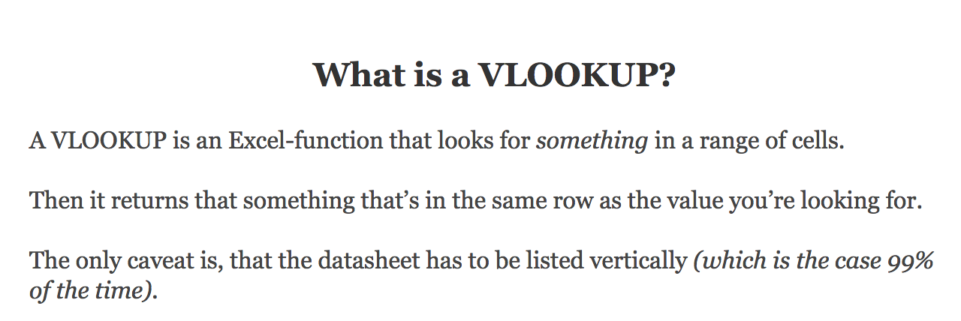
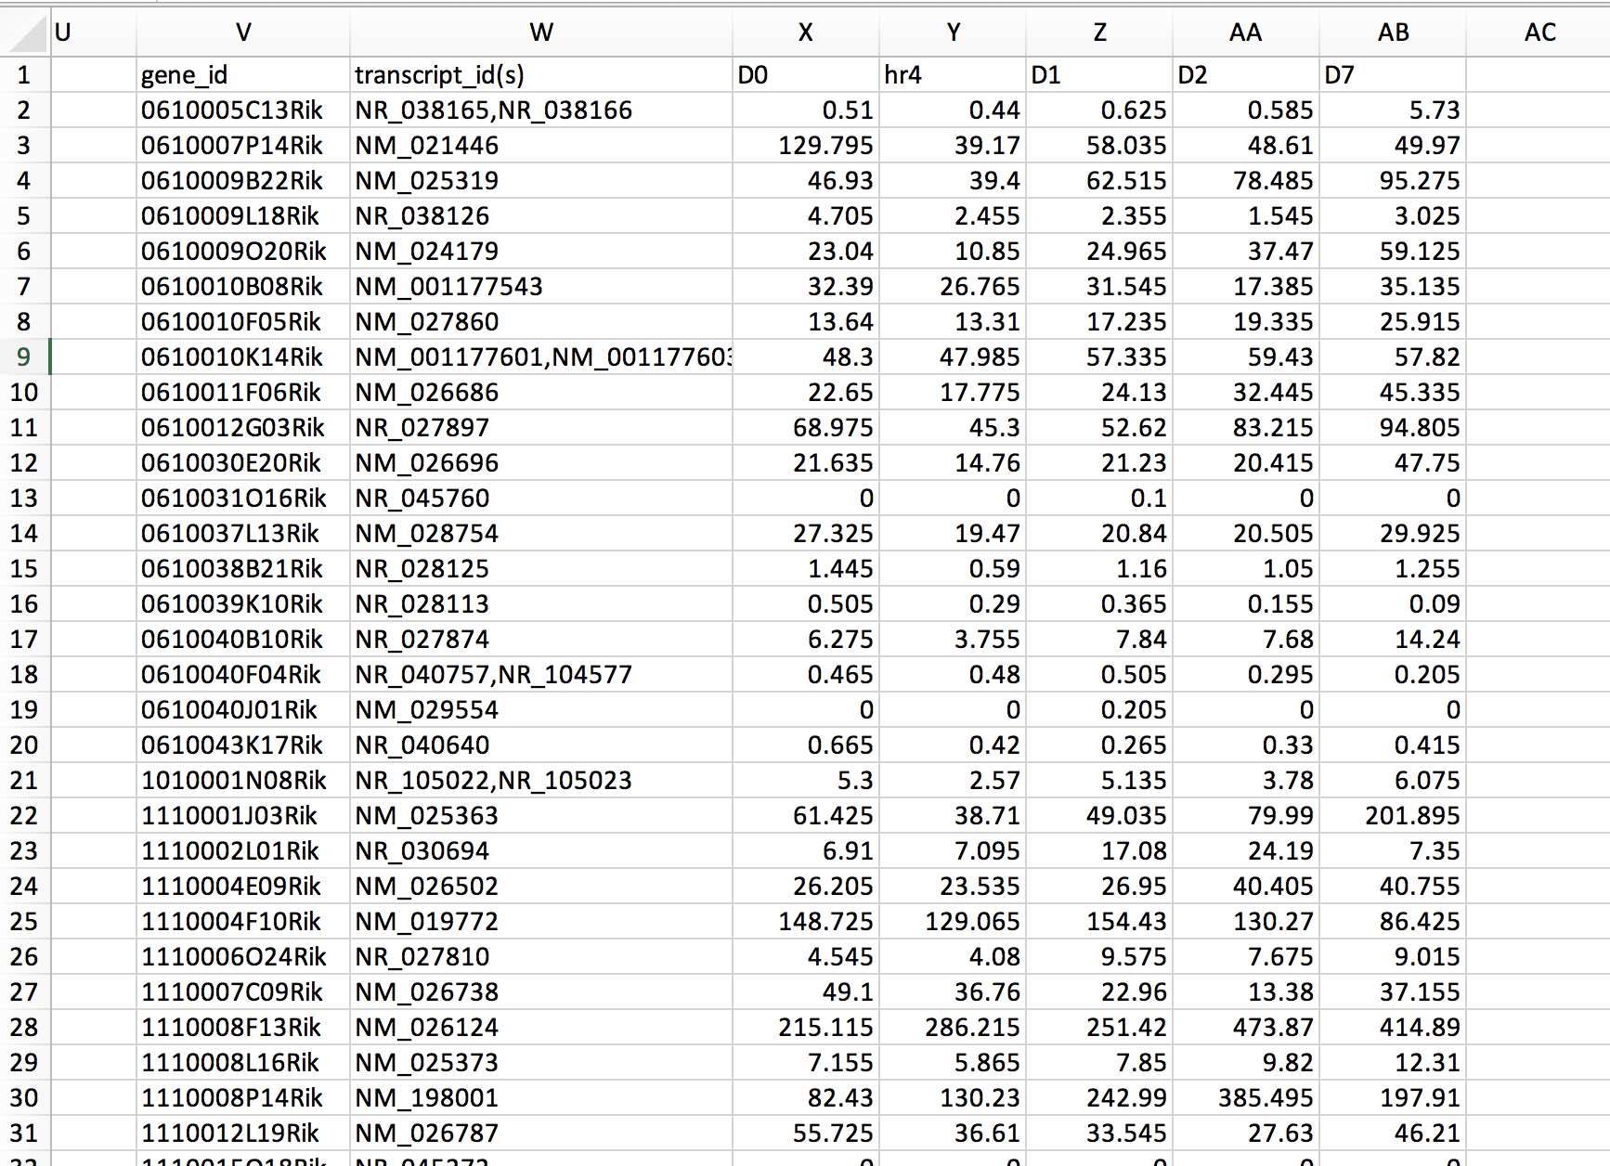
https://spreadsheeto.com/vlookup/
This is an example of a table assembled from RNA-Seq time course data. TPM expression values are reported for the entire genome of 23,845 genes.
Vlookup is very useful when trying to compile a list of genes of interest and to extract the adjacent expression info.

Slide 2
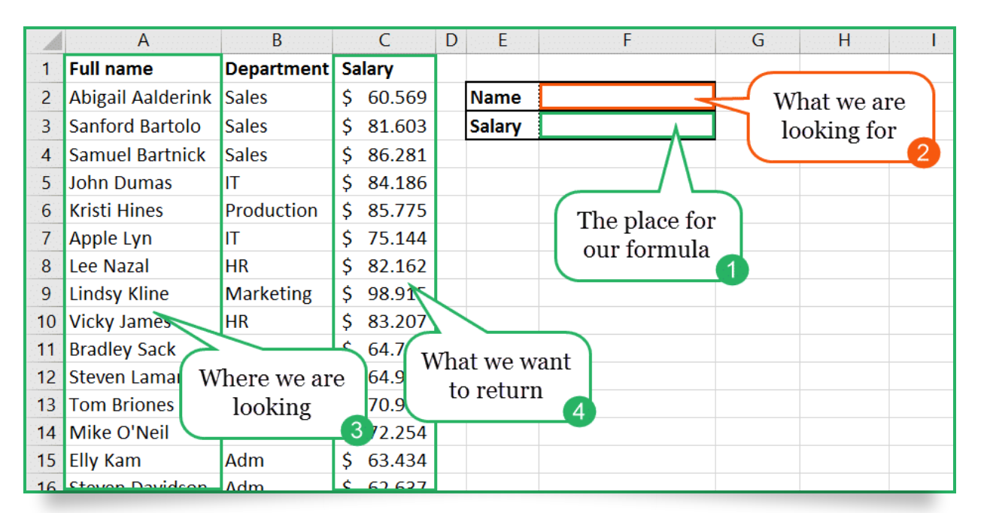
Vlookup Example

Slide 3
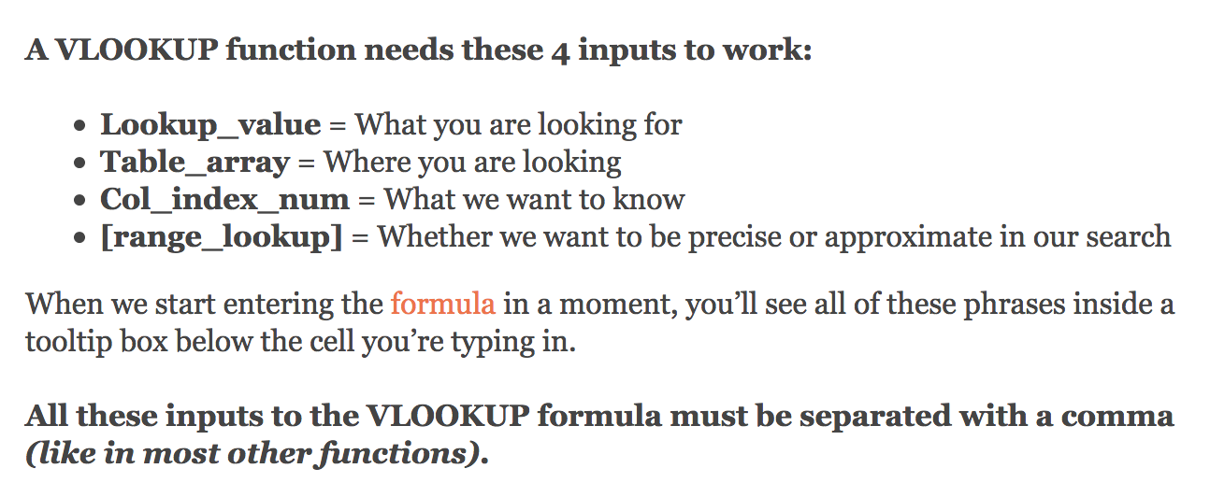
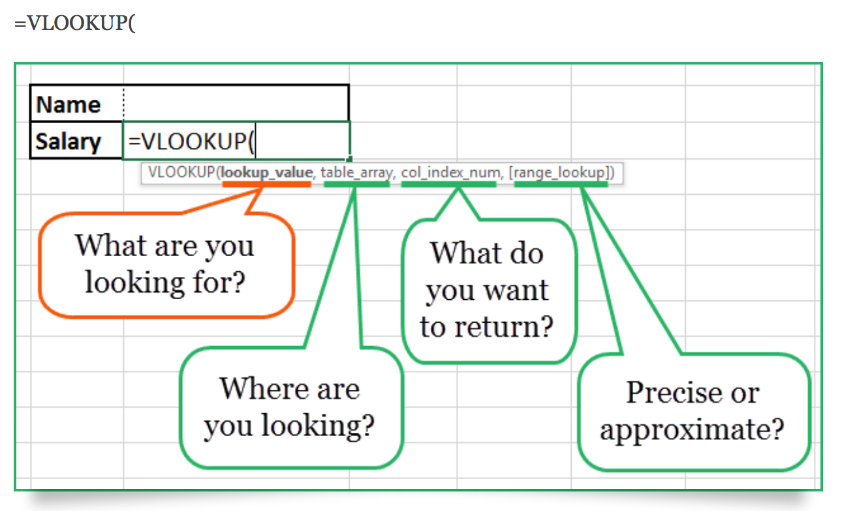

Slide 5
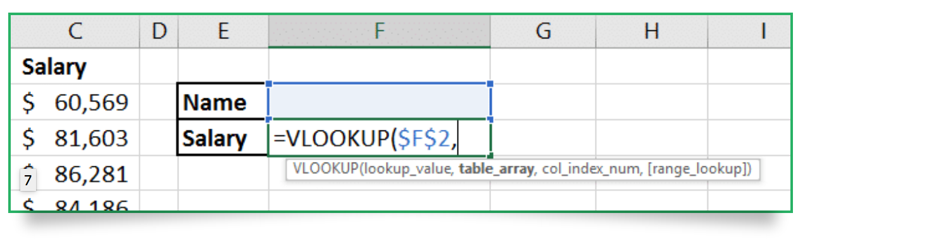

Slide 6
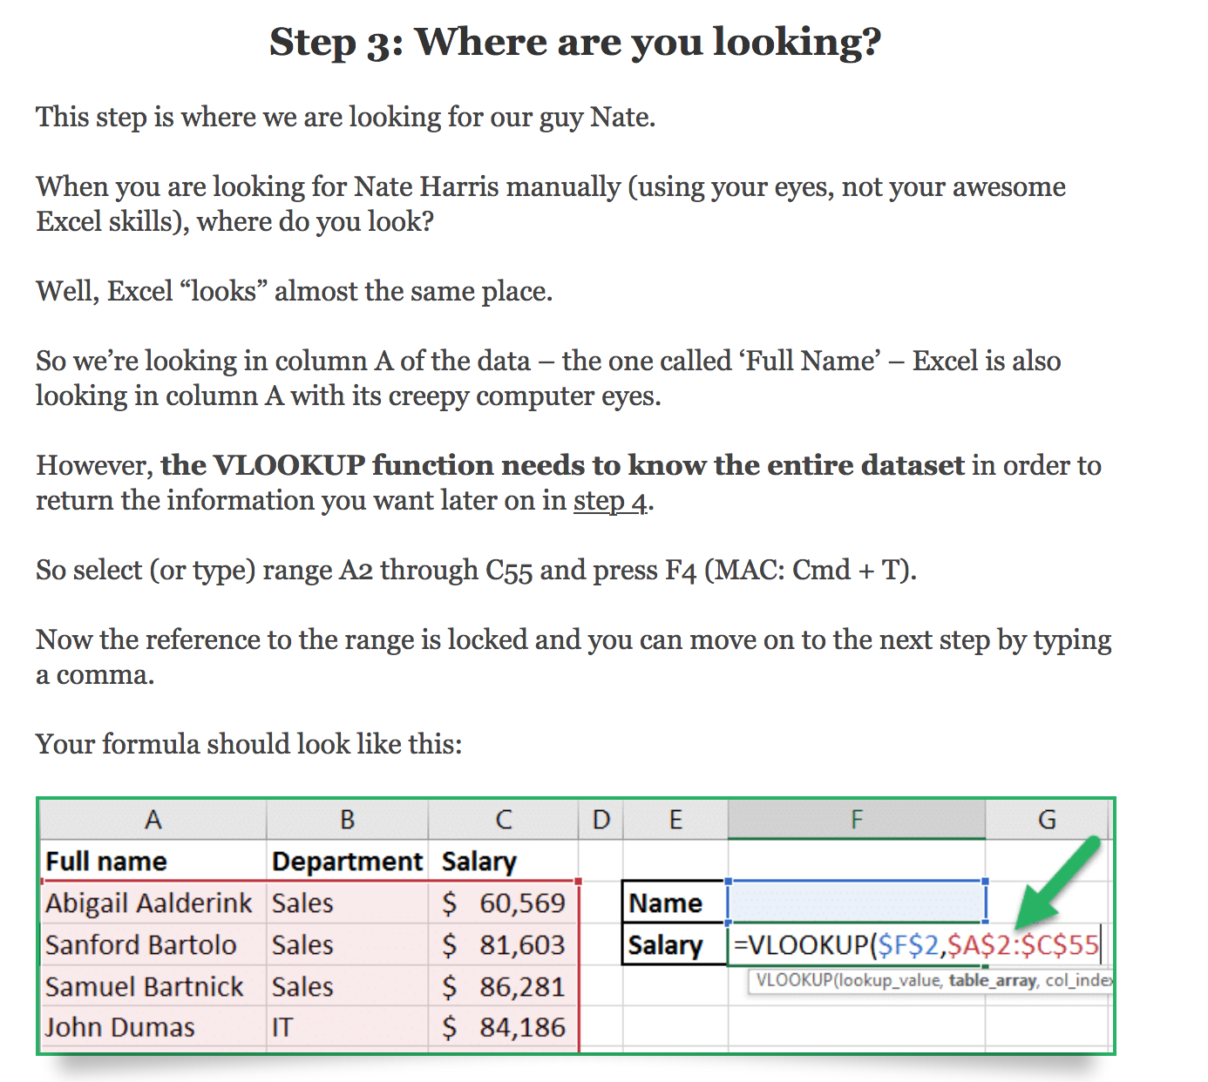

Slide 7
The third item that needs to be entered is which column of the array table you want to extract.

Slide 8
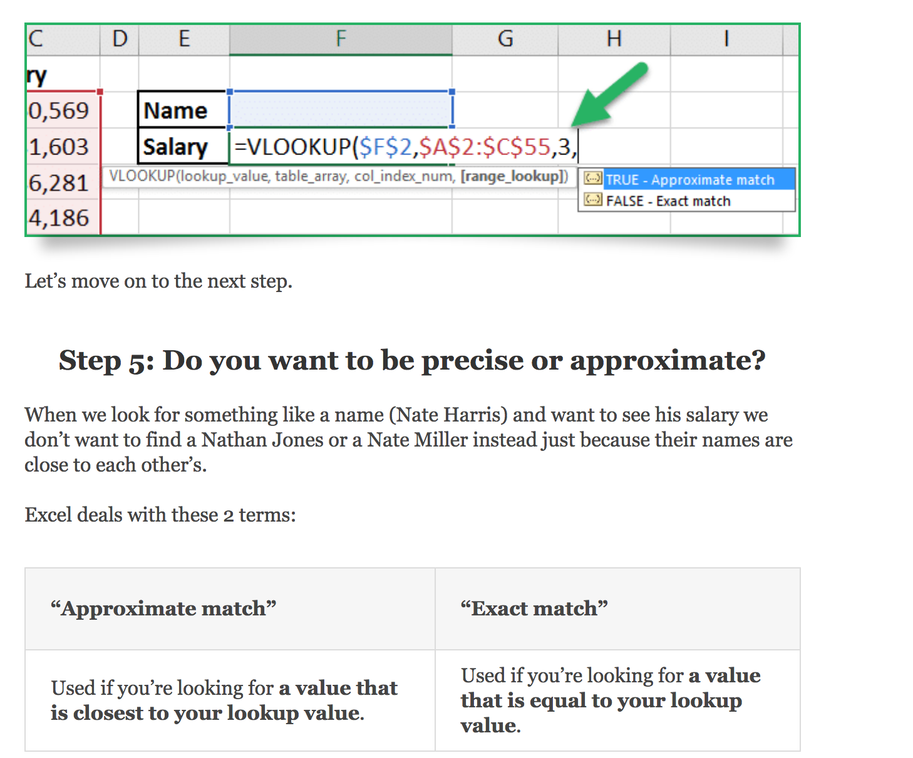
Last value to entre is FALSE so you only extract EXACT matches from your array table

Slide 9
This is an example of a table assembled from RNA-Seq time course data. TPM expression values are reported for the entire genome of 23,845 genes.
Vlookup is very useful when trying to compile a list of genes of interest and to extract the adjacent expression info.

Slide 10
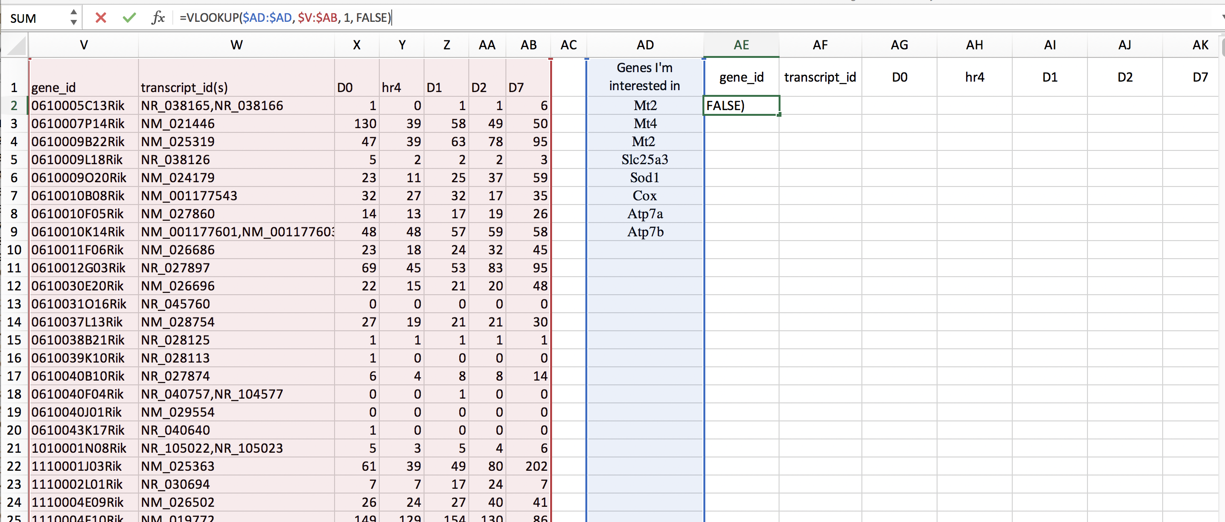

Slide 11
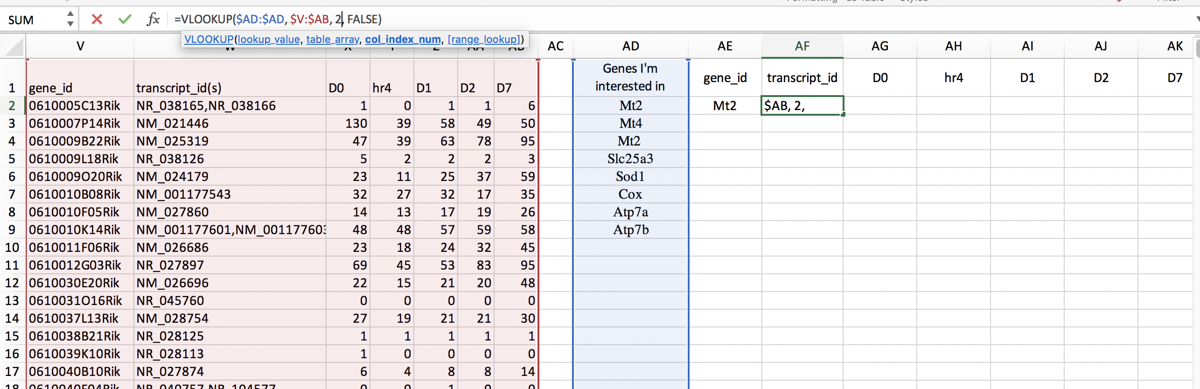
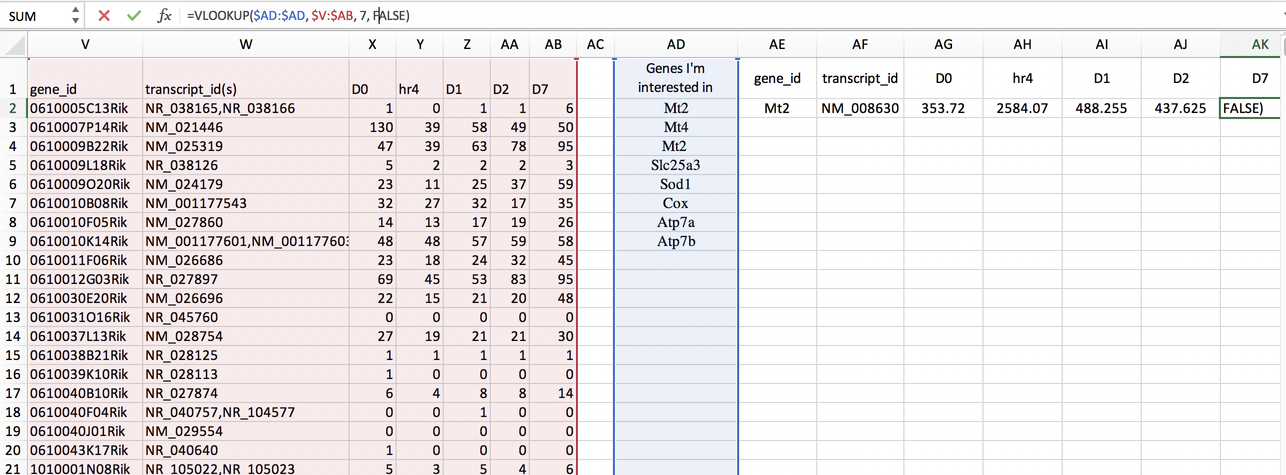
To pull the second column info from the array table, observe that the vlookup equation item col_index_num gets changed to a 2
Col_index_num gets changes to a 7 to pull the 7th columns info

Slide 12
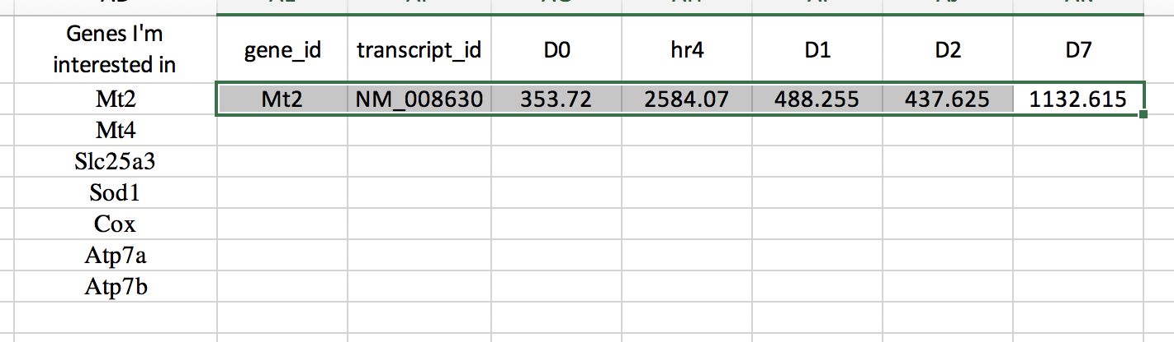
Copy and paste the first line to the remaining rows and the table will autofill with the appropriate RNA-Seq TPM values
Select row and drag down to copy paste

Slide 13
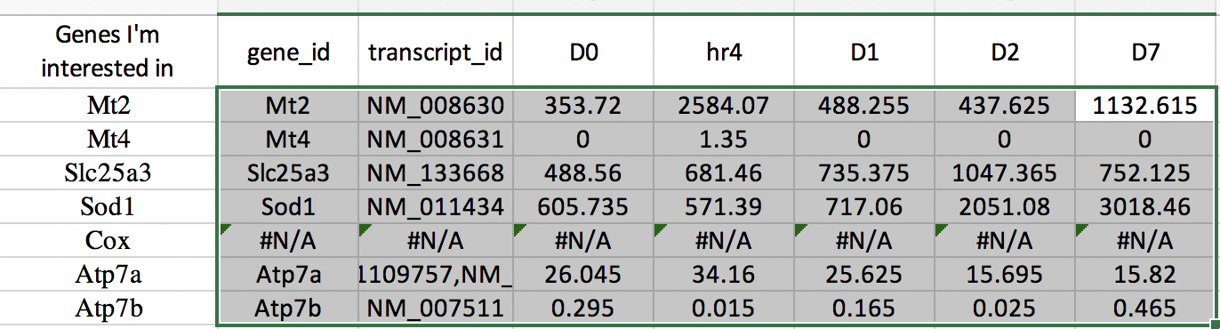
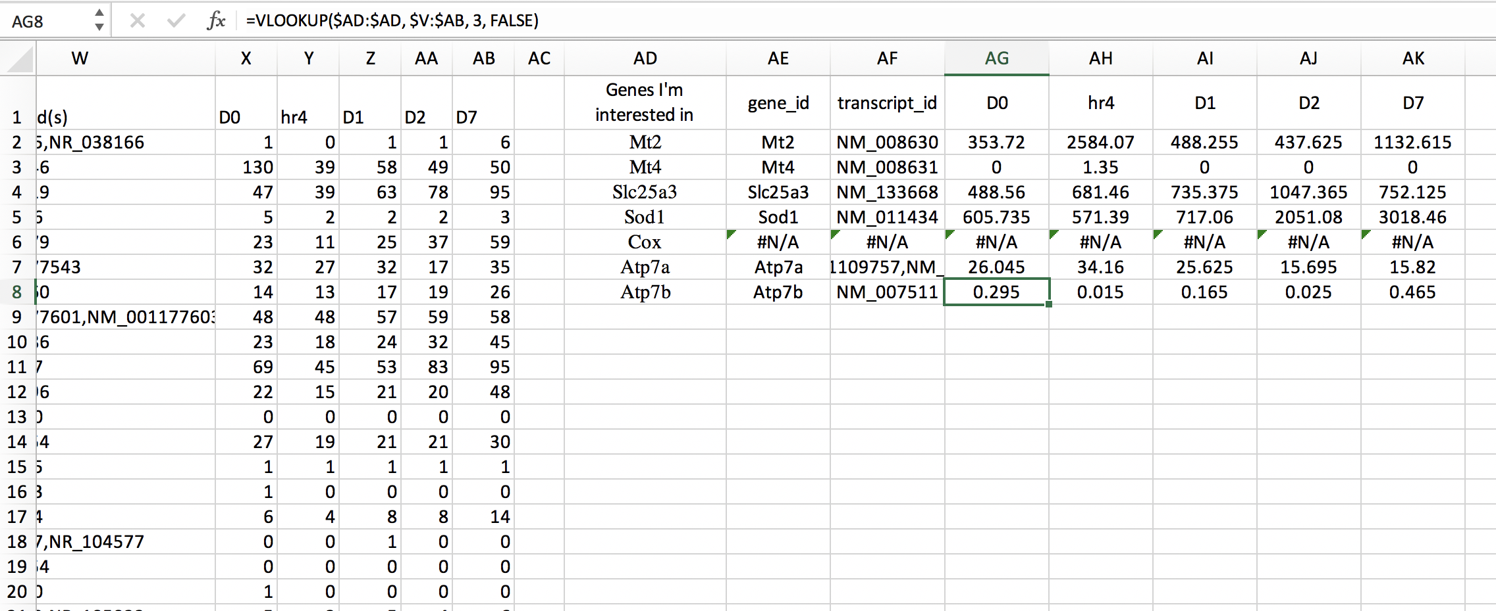
Look at the equation for cell AG7

Slide 14
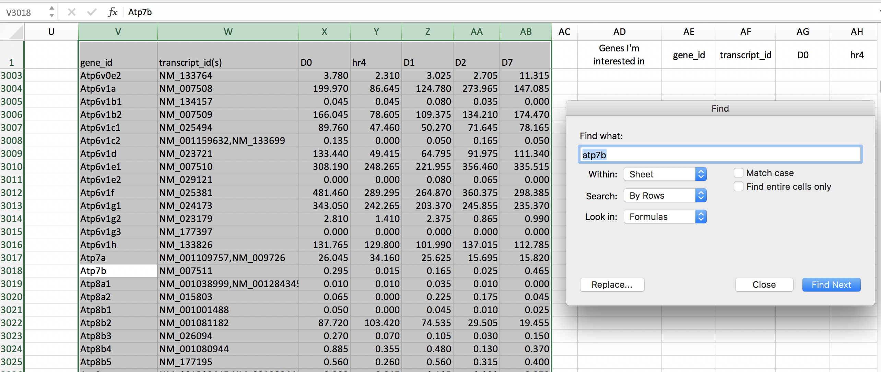
Confirm that vlookup is working by manually looking up Atp7B in the original table
You can see that vlookup pulled out the proper info for genes Atp7a and Atp7b

